Slide 1
PHYSICAL COMPUTING
DIGITAL HUMANITIES

Slide 2
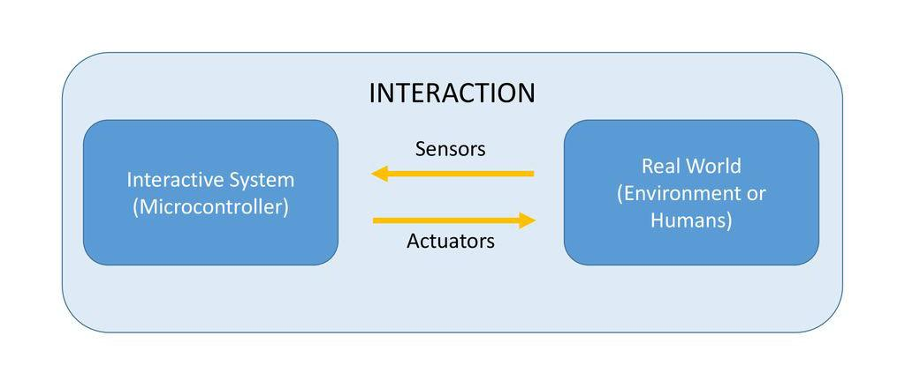
WHAT IS PHYSICAL COMPUTING?
Handmade art, design, or do-it-yourself hobby projects that use sensors and microcontrollers to translate input to a software system, and/or control electro-mechanical devices such as motors, lighting, or other hardware.

Slide 3
WHAT IS PHYSICAL COMPUTING?
Use of computing and electronics (sensors and actuators) in the prototyping of physical objects to interact with humans
Behavior implemented by software
Use of microcontrollers
The goal is to link the physical world with the virtual world
Way to create communication and interaction between people

Slide 4
HOW WE USE COMPUTERS
Productivity Future Vision (2011)
Possible ways we will interact with our computers
https://www.youtube.com/watch?v=a6cNdhOKwi0

Slide 5
RICHARD HAMMING – 1968 TURING AWARD LECTURE
Isaac Newton wrote to Robert Hooke in 1675, “If I have seen further, it is by standing on the shoulders of giants.”
Richard Hamming added to that “I am forced to say, today we stand on each other’s feet,” and “Perhaps the central problem we face in all of computer science is how we are to get to the situation where we build on top of the work of others, rather than redoing so much of it in a trivially different way. Science is supposed to be cumulative, not almost endless duplication of the same kinds of things.”

Slide 6
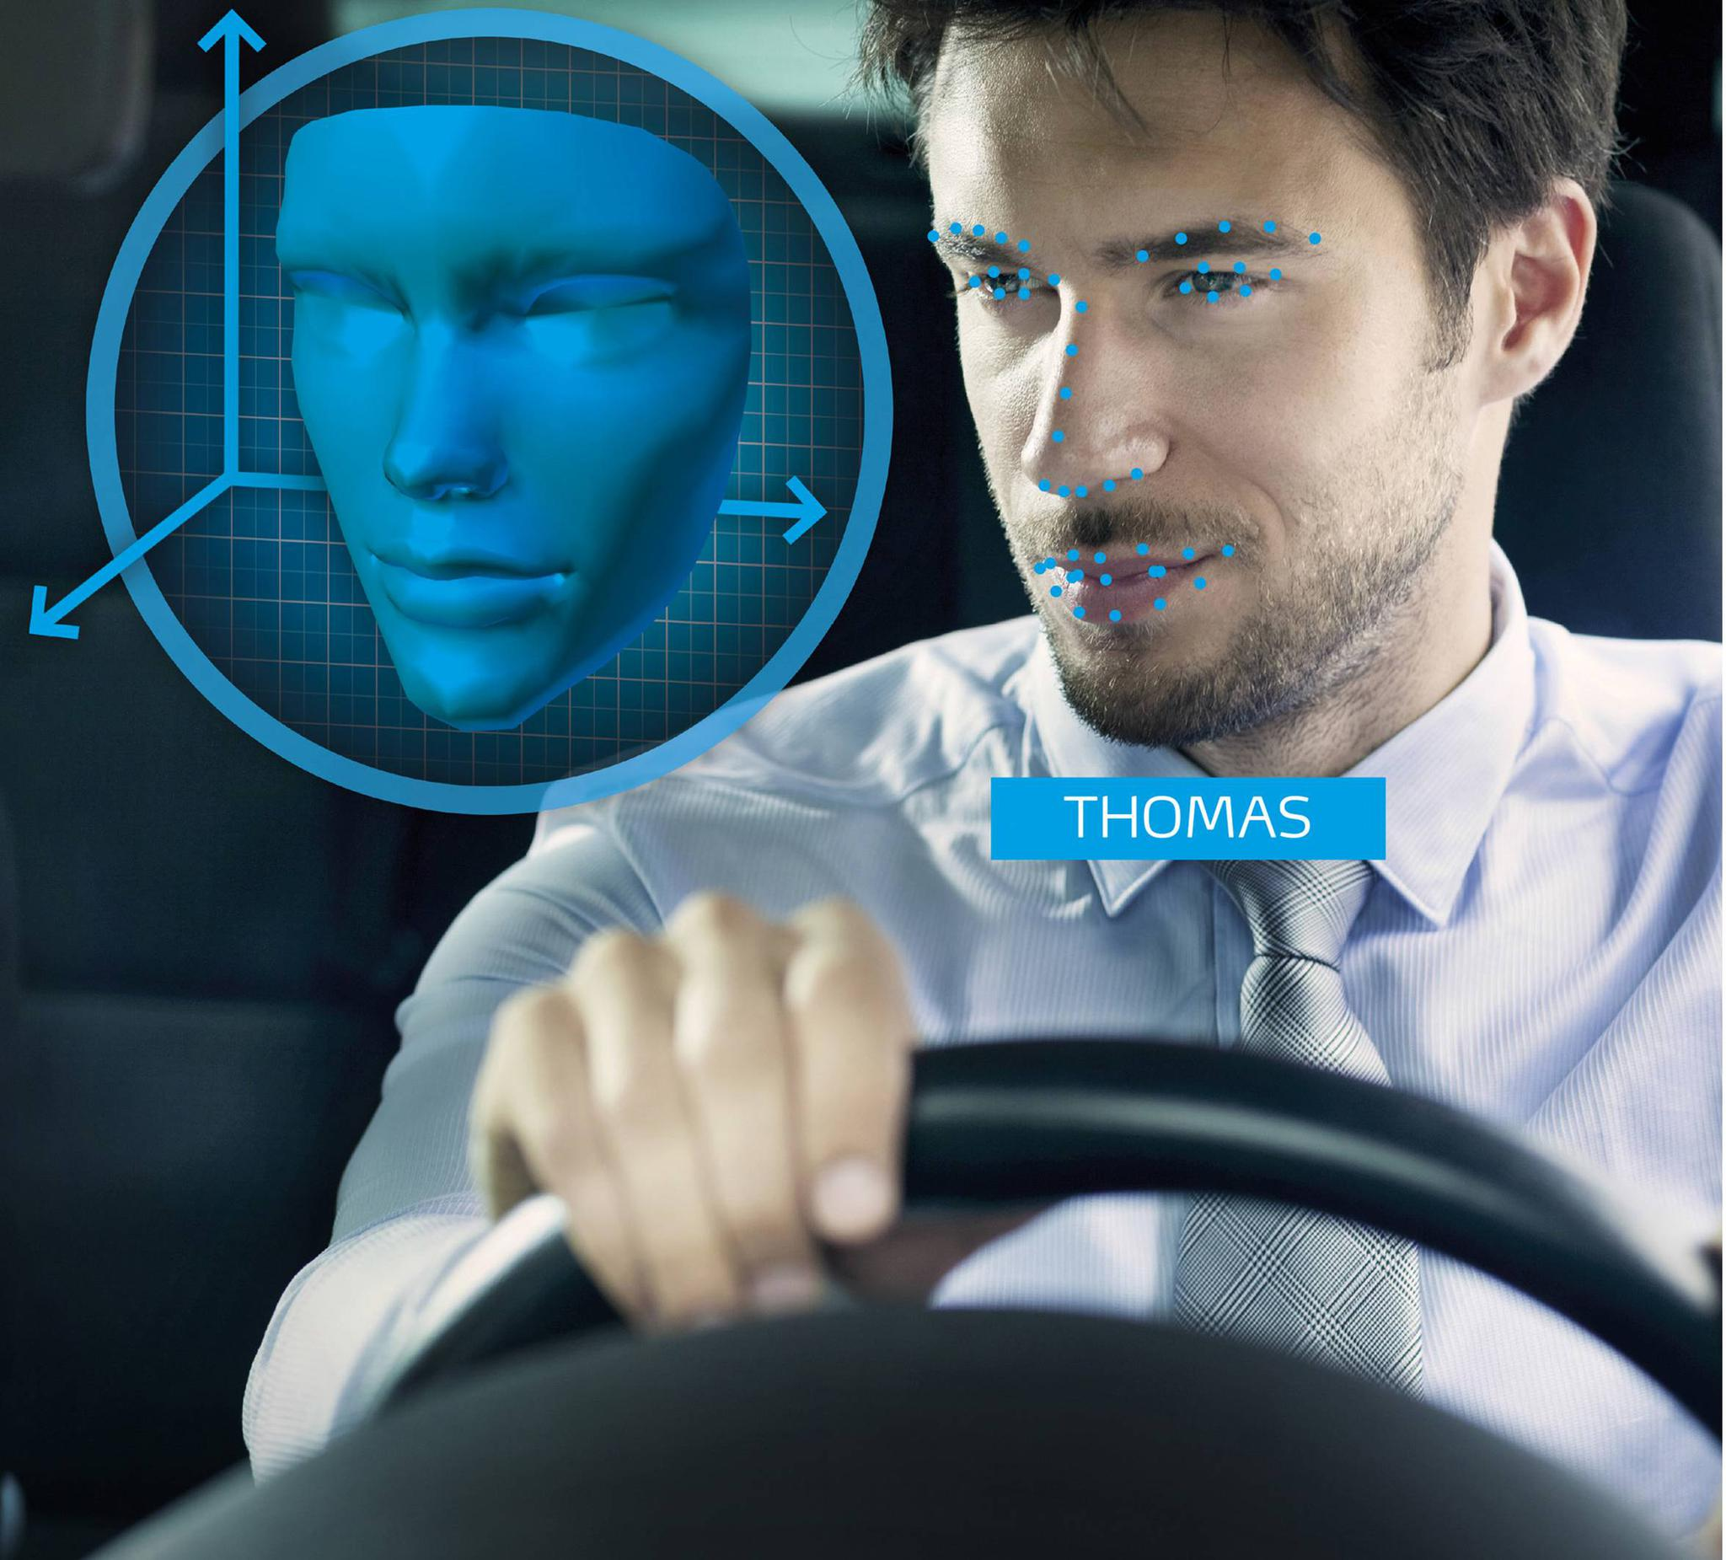
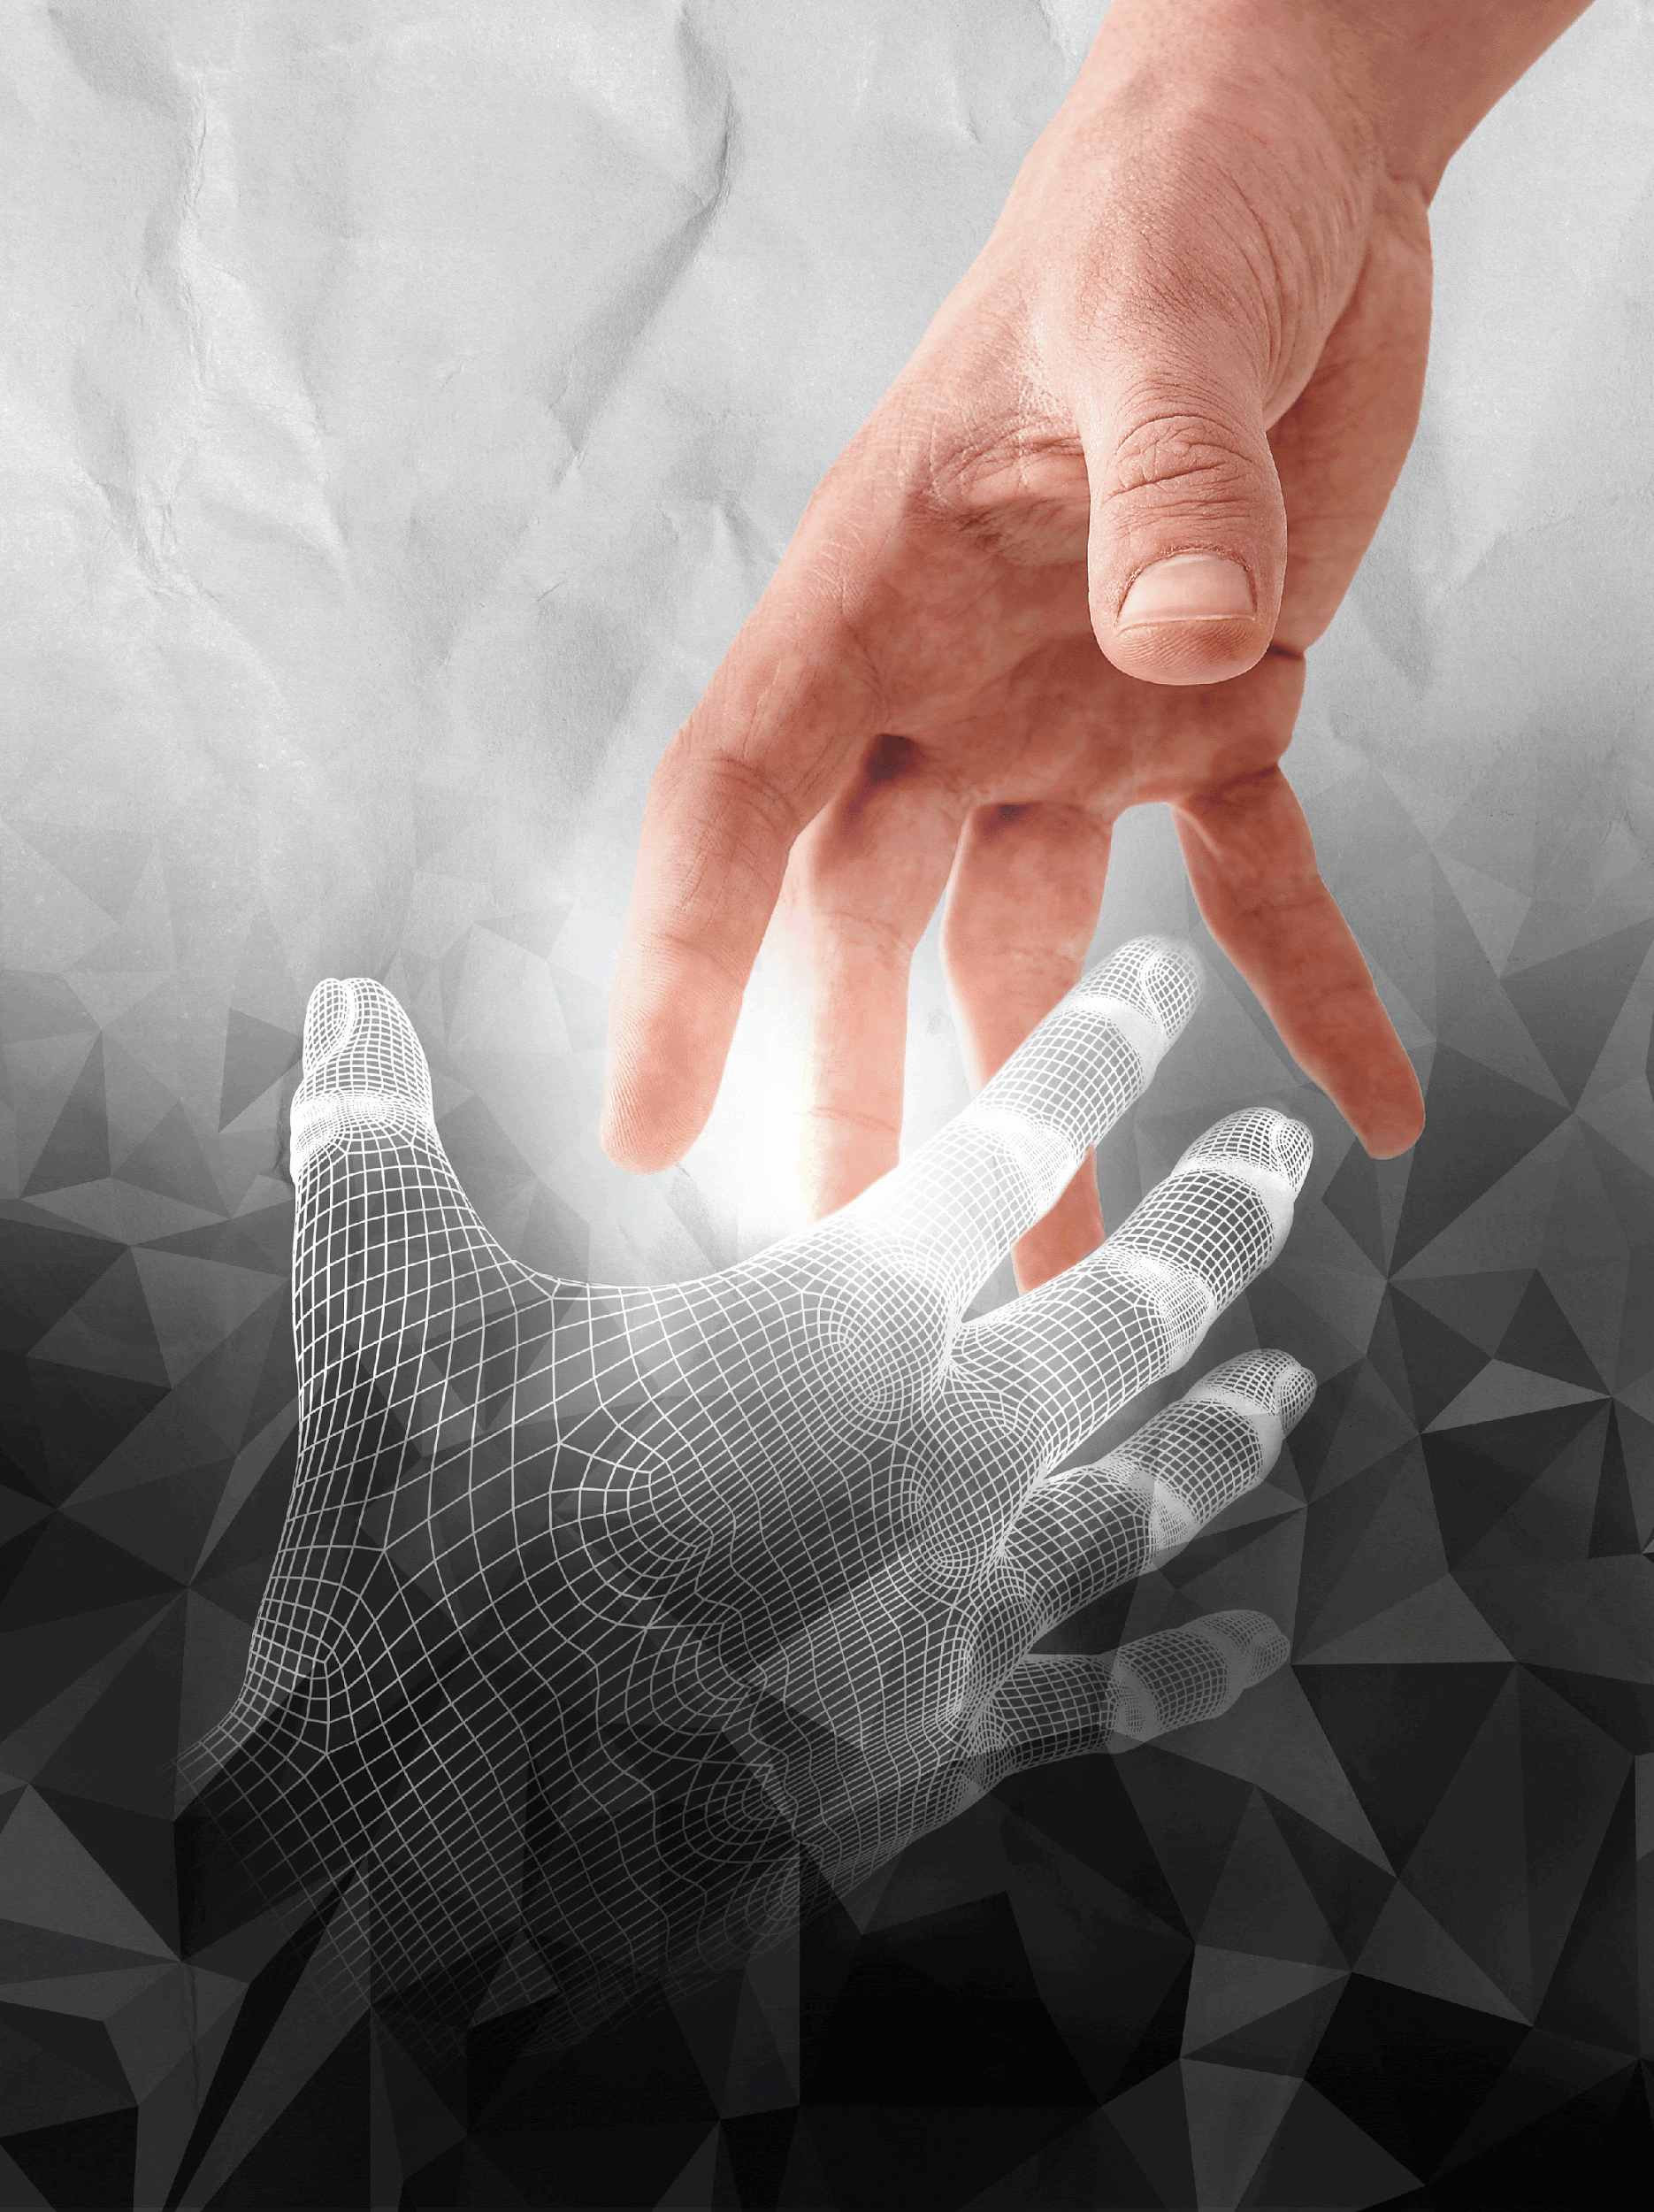
TOM IGOE – 2018 PHYSICAL COMPUTING LECTURE
“Change the way that computers see us will change how they interact with us.”

Slide 7
ARDUINO – PHYSICAL COMPUTING TOOL
Arduino is a tool for making computers that can sense and control more of the physical world than your desktop computer.
https://www.arduino.cc/
Arduino intro – https://www.youtube.com/watch?v=CqrQmQqpHXc

Slide 8
DRAWDIO – PHYSICAL COMPUTING TOOL
Drawdio – circuit-craft that allows you to turn everyday objects into musical instruments.
https://drawdio.com/
Drawdio examples - https://www.youtube.com/watch?time_continue=5&v=PV_w38ldZaE

Slide 9
LASER HARP!!
Ever want a Laser Harp? Well now you can build one as a DYI project!
Laser Harp demo – https://www.youtube.com/watch?v=sLVXmsbVwUs
How to build a Laser Harp – https://www.youtube.com/watch?v=Xw_L-GN4V5M

Slide 10
MORE PHYSICAL COMPUTING TECH
MakeyMakey - https://makeymakey.com/
Phidgets - https://www.phidgets.com/?
RaspberryPi - https://www.raspberrypi.org/
Gadgeteer - https://the-gadgeteer.com/

Slide 11
WHO’S WORKING ON PHYSICAL COMPUTING?
MIT Tangible Media - https://tangible.media.mit.edu/
“The Tangible Media Group, led by Professor Hiroshi Ishii, explores the Tangible Bits & Radical Atoms visions to seamlessly couple the dual world of bits and atoms by giving dynamic physical form to digital information and computation.”

Slide 12
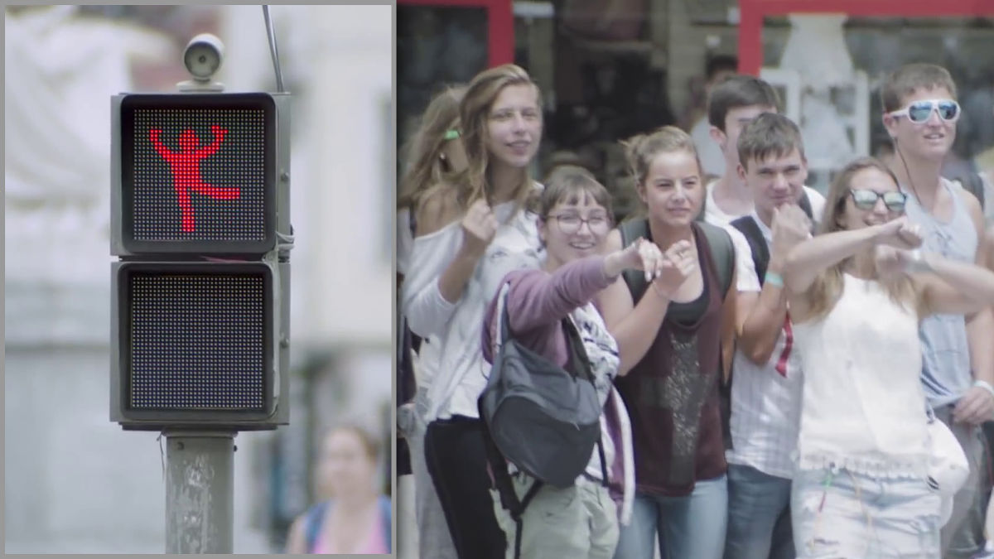
CAN PHYSICAL COMPUTING BE FUN AND PRACTICAL?
Dancing Traffic Light Manikin, by smart
YouTube video - https://www.youtube.com/watch?v=SB_0vRnkeOk

Slide 13
WHY IS PHYSICAL COMPUTING ON THE RISE?
Miniaturization costs are getting lower and lower.
The number of connected devices are on the rise:
2010 – 5 billion devices/global population of 7 billion people
2020 – 20 billion devices/global population of 7.7 billion people
Internet of Things (IoT) – The IoT is the interconnection of uniquely identifiable embedded computing devices within the existing

Slide 14
INTERNET OF THINGS (IoT)
IoT allows us to interact with a network of smart devices and extract information. We can ask them where they came from, who owns them, what they do, etc.
Imagine the information that could be gathered from billions or trillions of smart objects.

Slide 15
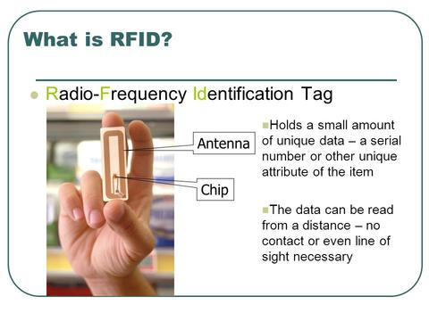
RFID - Radio Frequency ID - Tag
Radio Frequency Identification (RFID) Tag

Slide 16
IOT EMERGED FROM RFID WORLD
IoT was presented/used in 1999 by Kevin Ashton, Director of Auto-ID Labs at MIT.
Ashton postulated that if objects were tagged with RFID they could become a part of a vast network of sensors. These objects could be found and tracked, so that there was an Internet of Things.

Slide 17
NEAR FIELD COMMUNICATION (NFC)
Point to point communication
RFID-based technology
Multiple uses
Connects apps with the real world
Connects devices
Connects your virtual wallet
“What is NFC Technology?” https://www.youtube.com/watch?v=Wim4TqMzgVQ

Slide 18
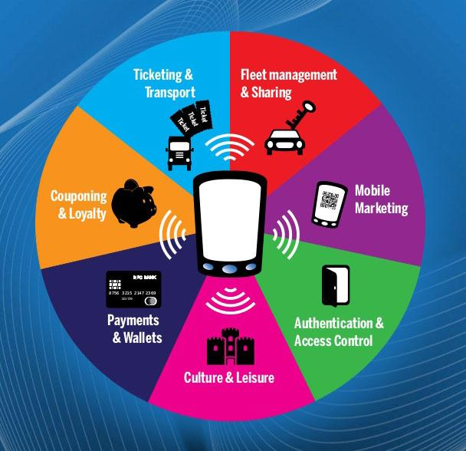
NFC EXAMPLES

Slide 19
CONCLUSION
Physical computing is a creative framework for understanding human beings' relationship to the digital world.
Physical Computing intersects the range of activities often referred to in academia and industry as electrical engineering, mechatronics, robotics, computer science, and especially embedded development.

